Slide 1
USDX/USDR Digital setup
Basic wiring diagram for working digital on WSJT-X (version 1.0 initial draft))

Slide 2
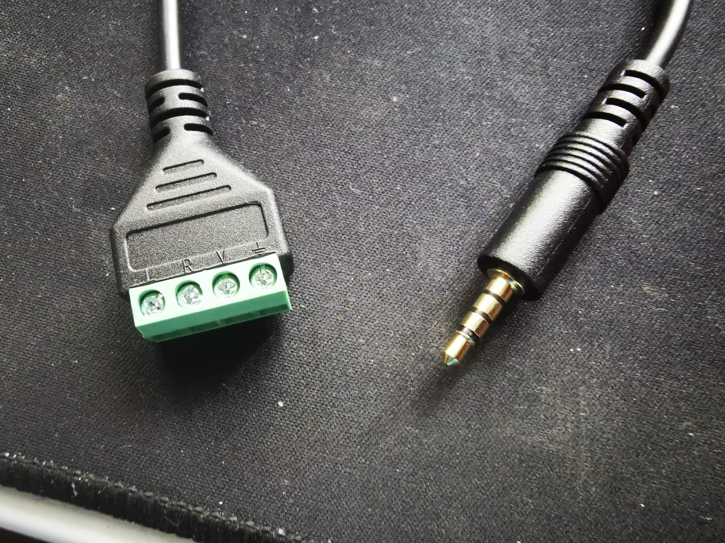
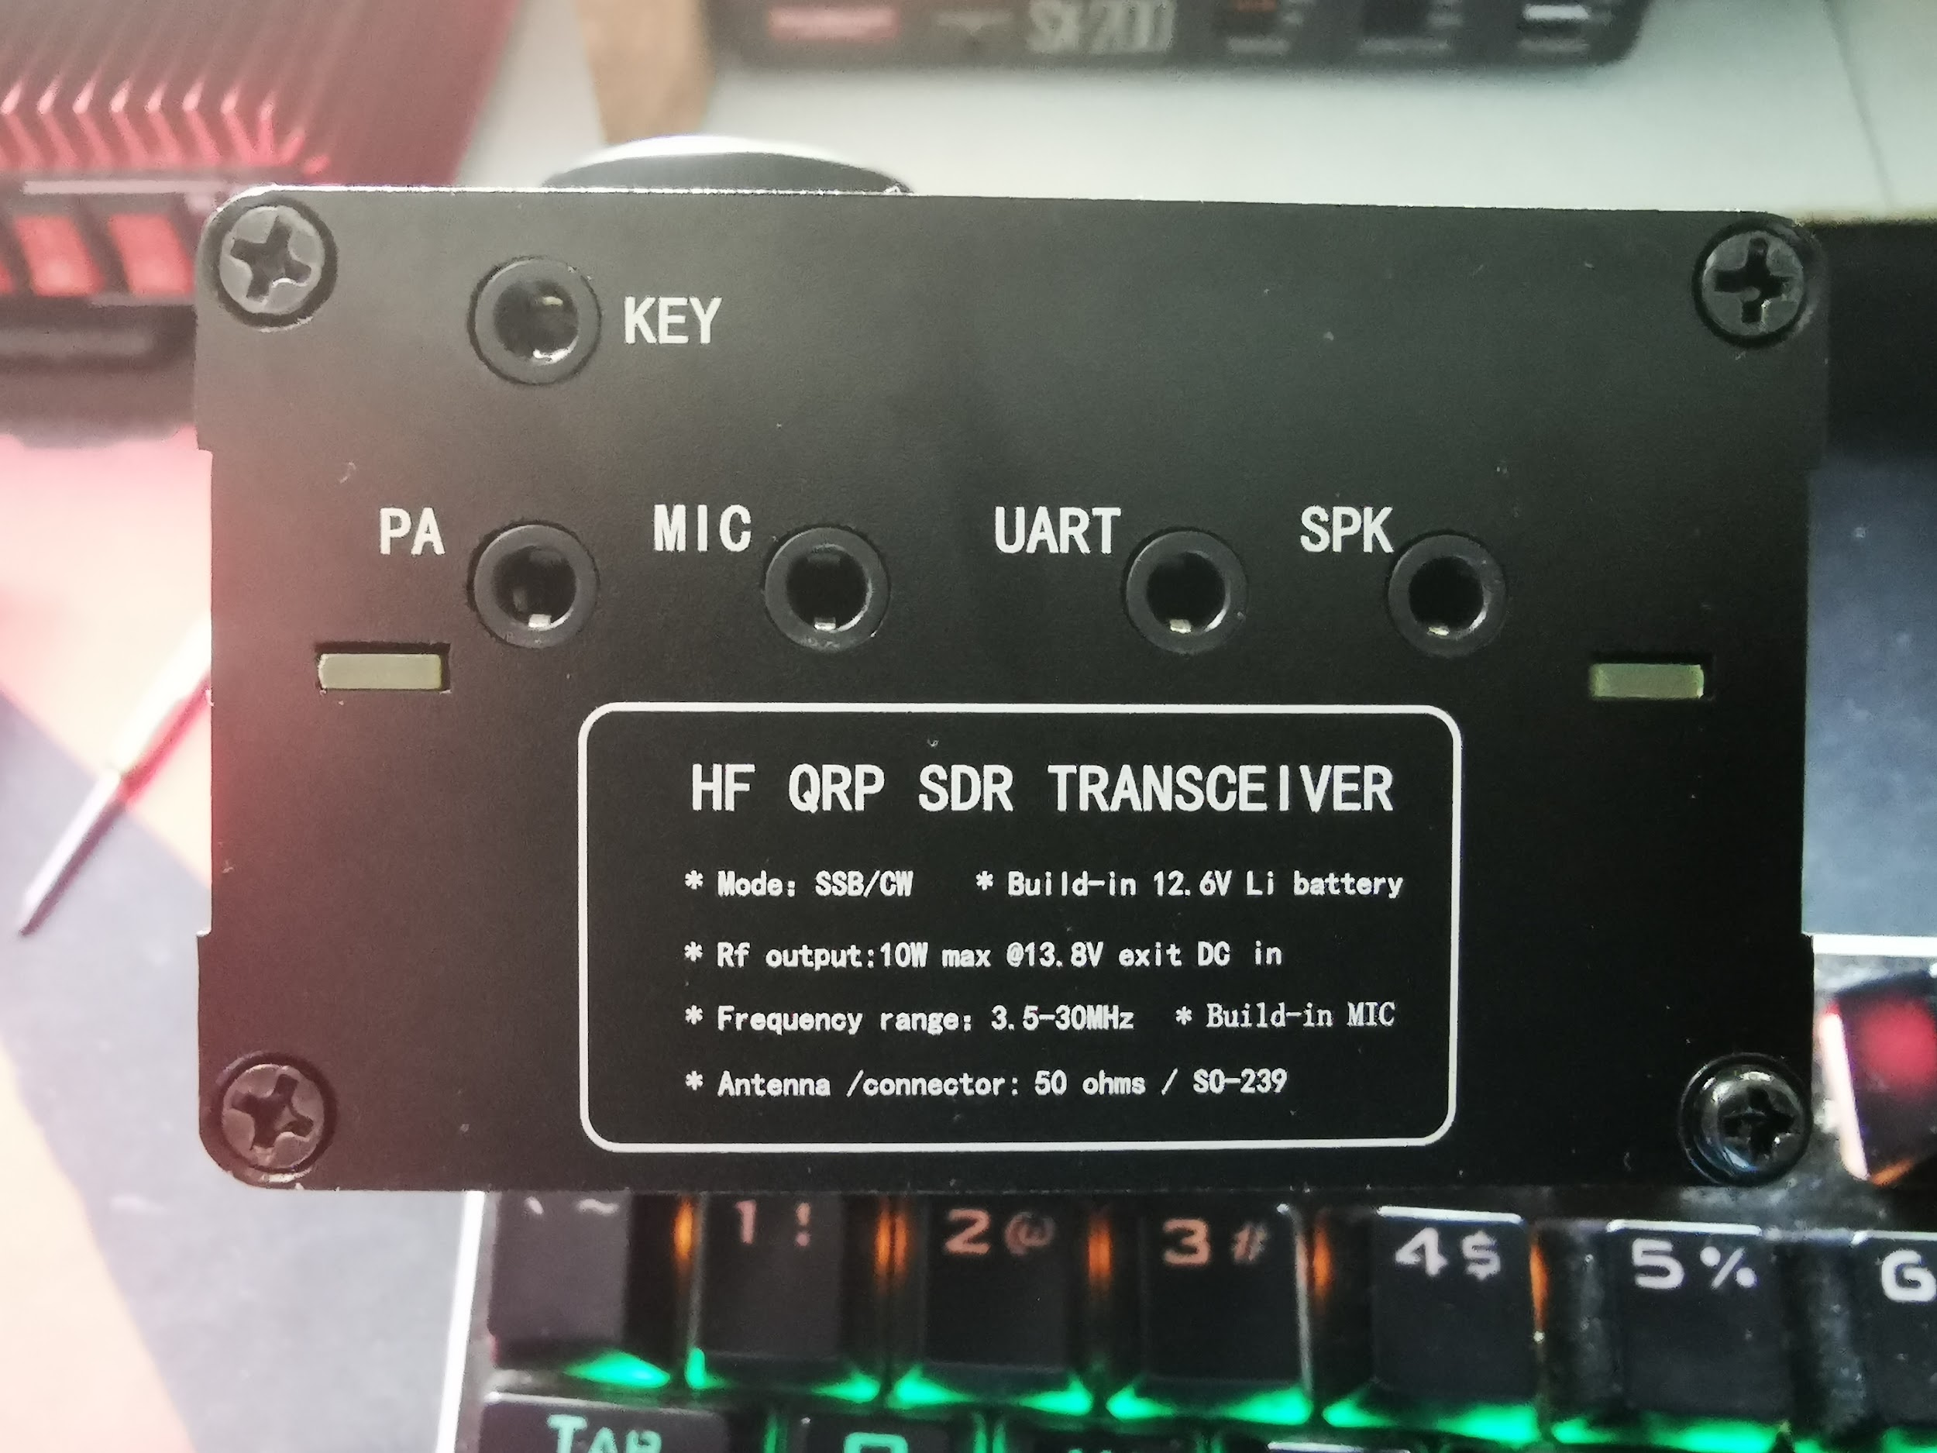
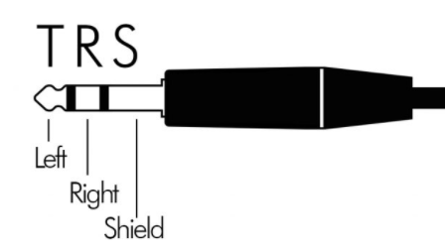
Connect USDX for I/O AF in/out
You can also use these for the TRRS plug to uSDX
Mic
Gnd
Gnd
Mic
Connecting AF input/output from uSDX to the PC soundcard.
Gnd
Note: For the AF signal on TX via VOX, I wired a TRS to TRRS but just used 2 lines, the mic and gnd only (your call if you use left or right on the TRS side.
Mic
Mic
Gnd
AF output from PC
AF Input to PC
Ordinary TRS male to male 3.5mm jack

Slide 3
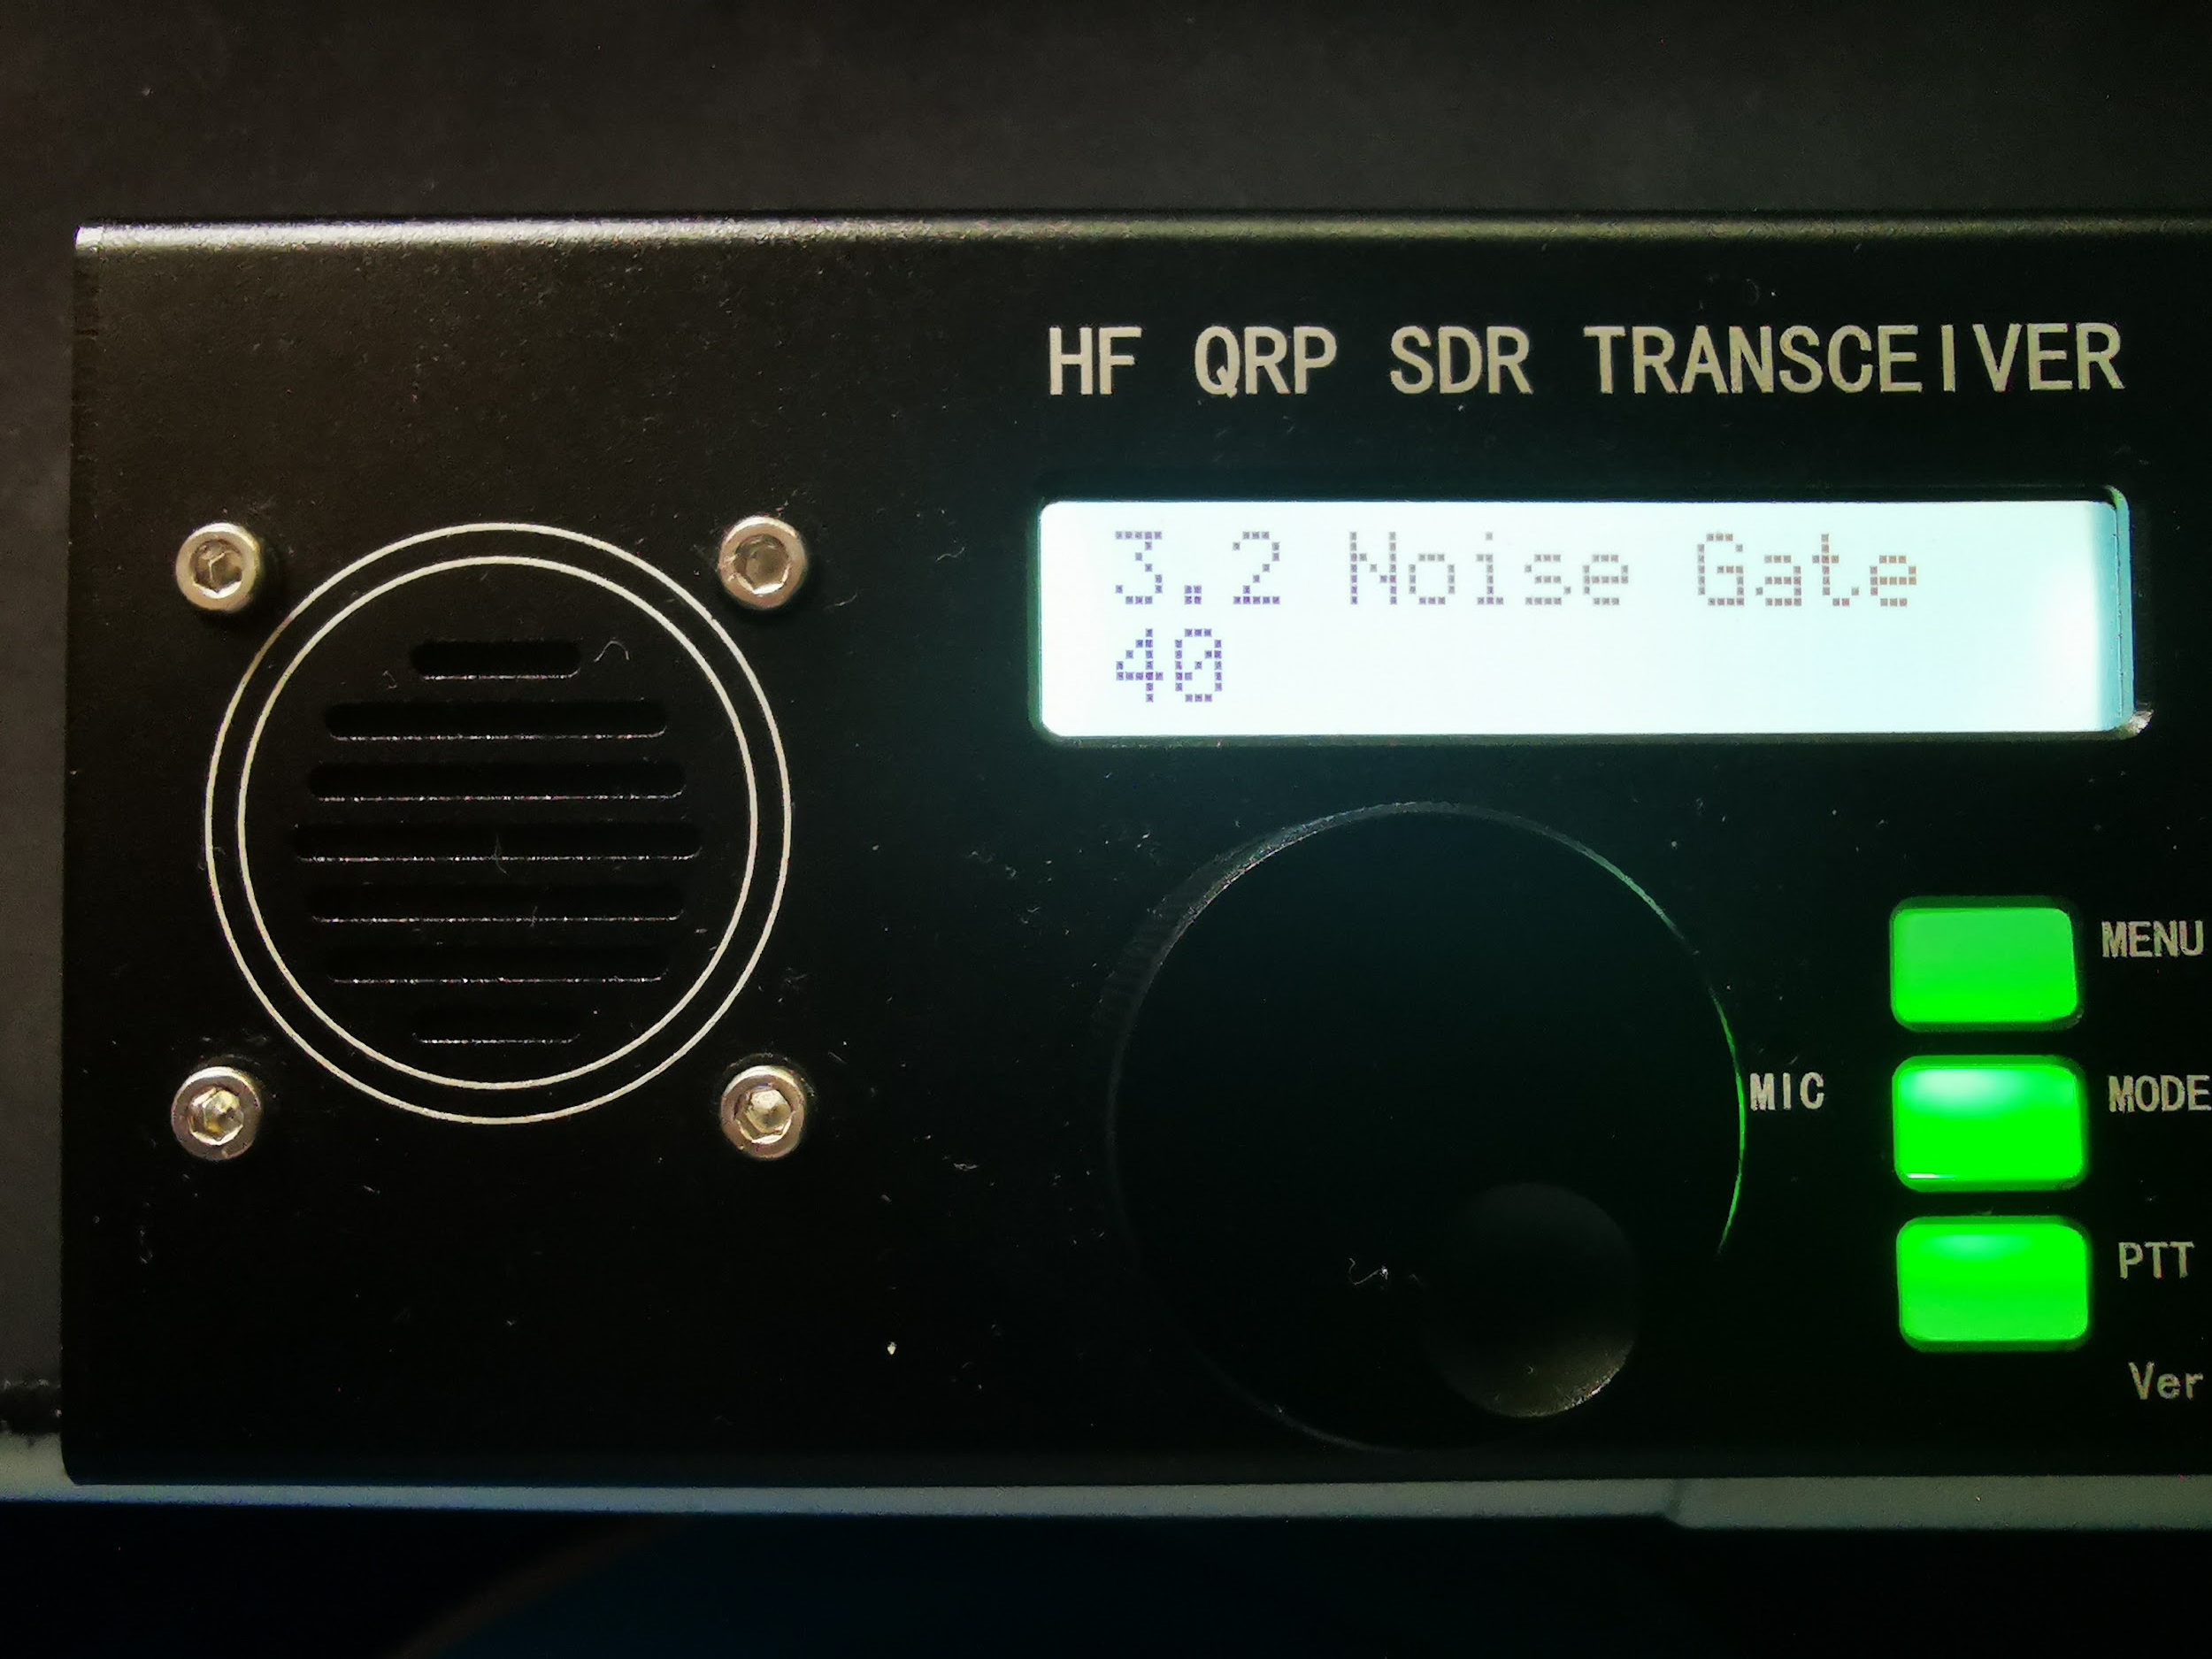
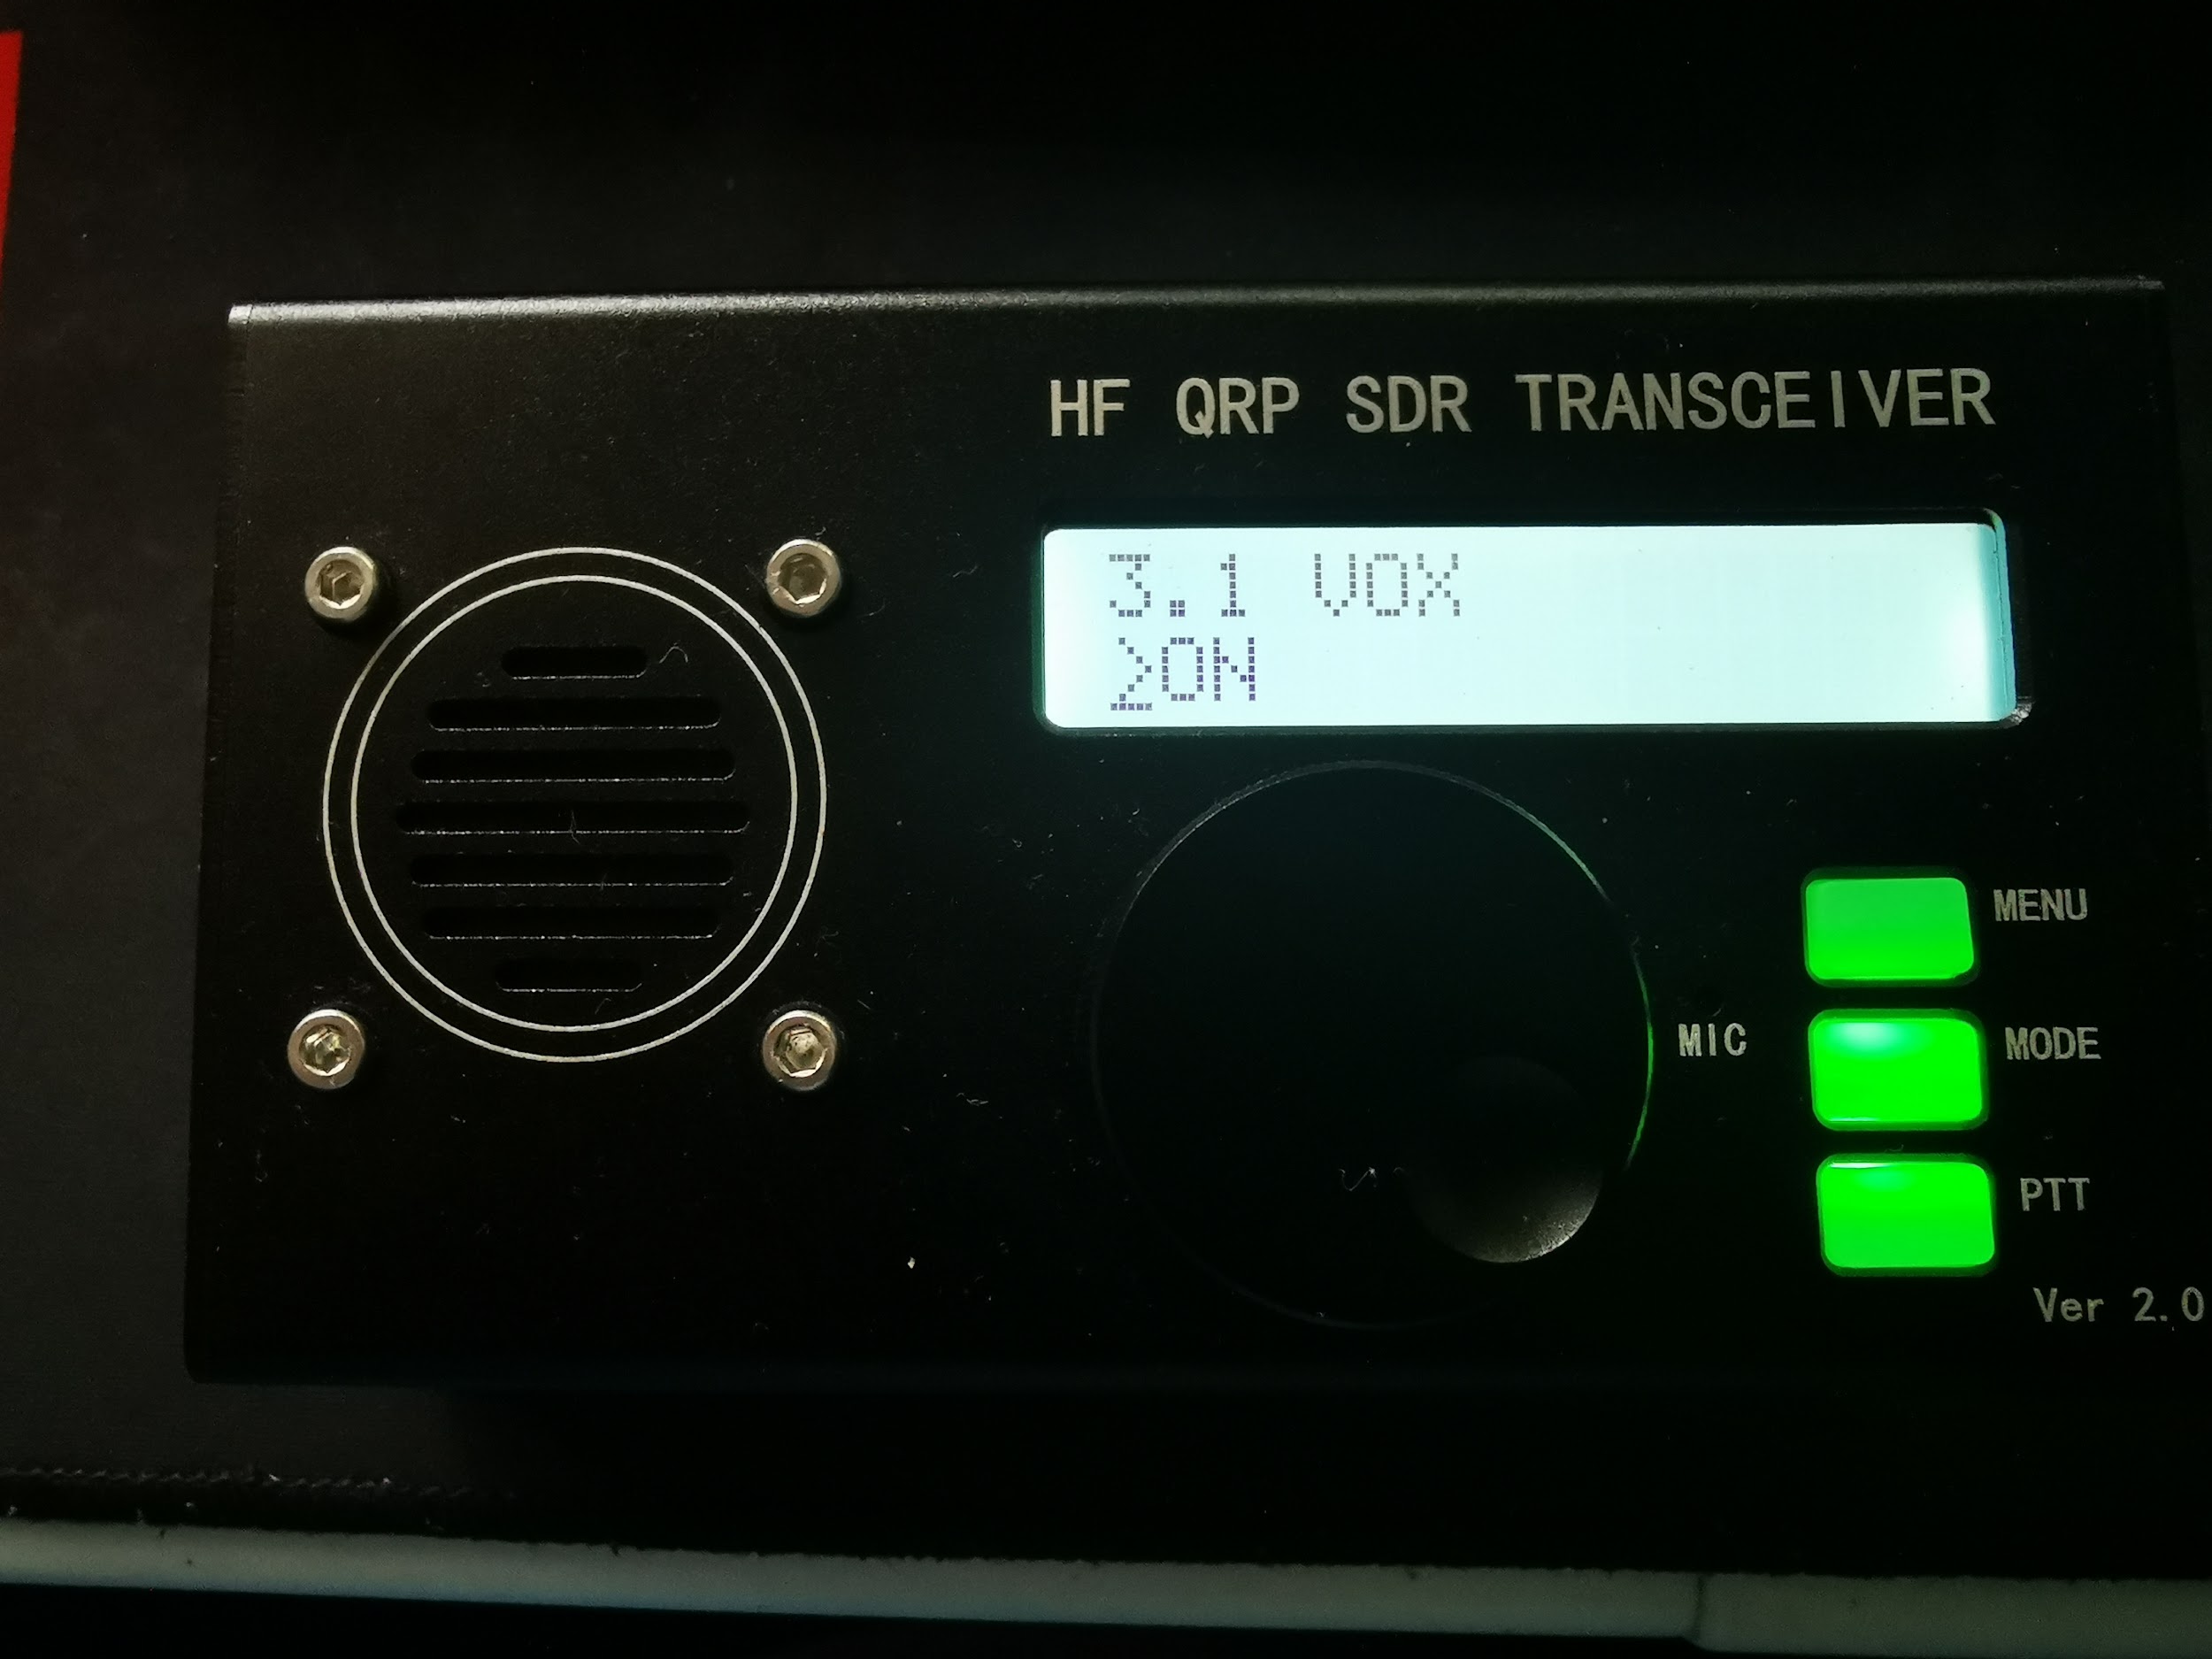
uSDX settings
Settings on uSDX The most significant parameter to set is the “VOX = on” and “Noise gate = 40”, so that the audio from PC to uSDX will be able to trigger the TX of the radio without the VOX getting too sensitive and getting trigger by ambient audio/RF.
uSDX settings
Tx drive = 4
PA bias min = 0 (depends on what works for your uSDX)
PA bias max = 190 (same)
Noise Gate = 40
VOX = on
Others - TBD

Slide 4
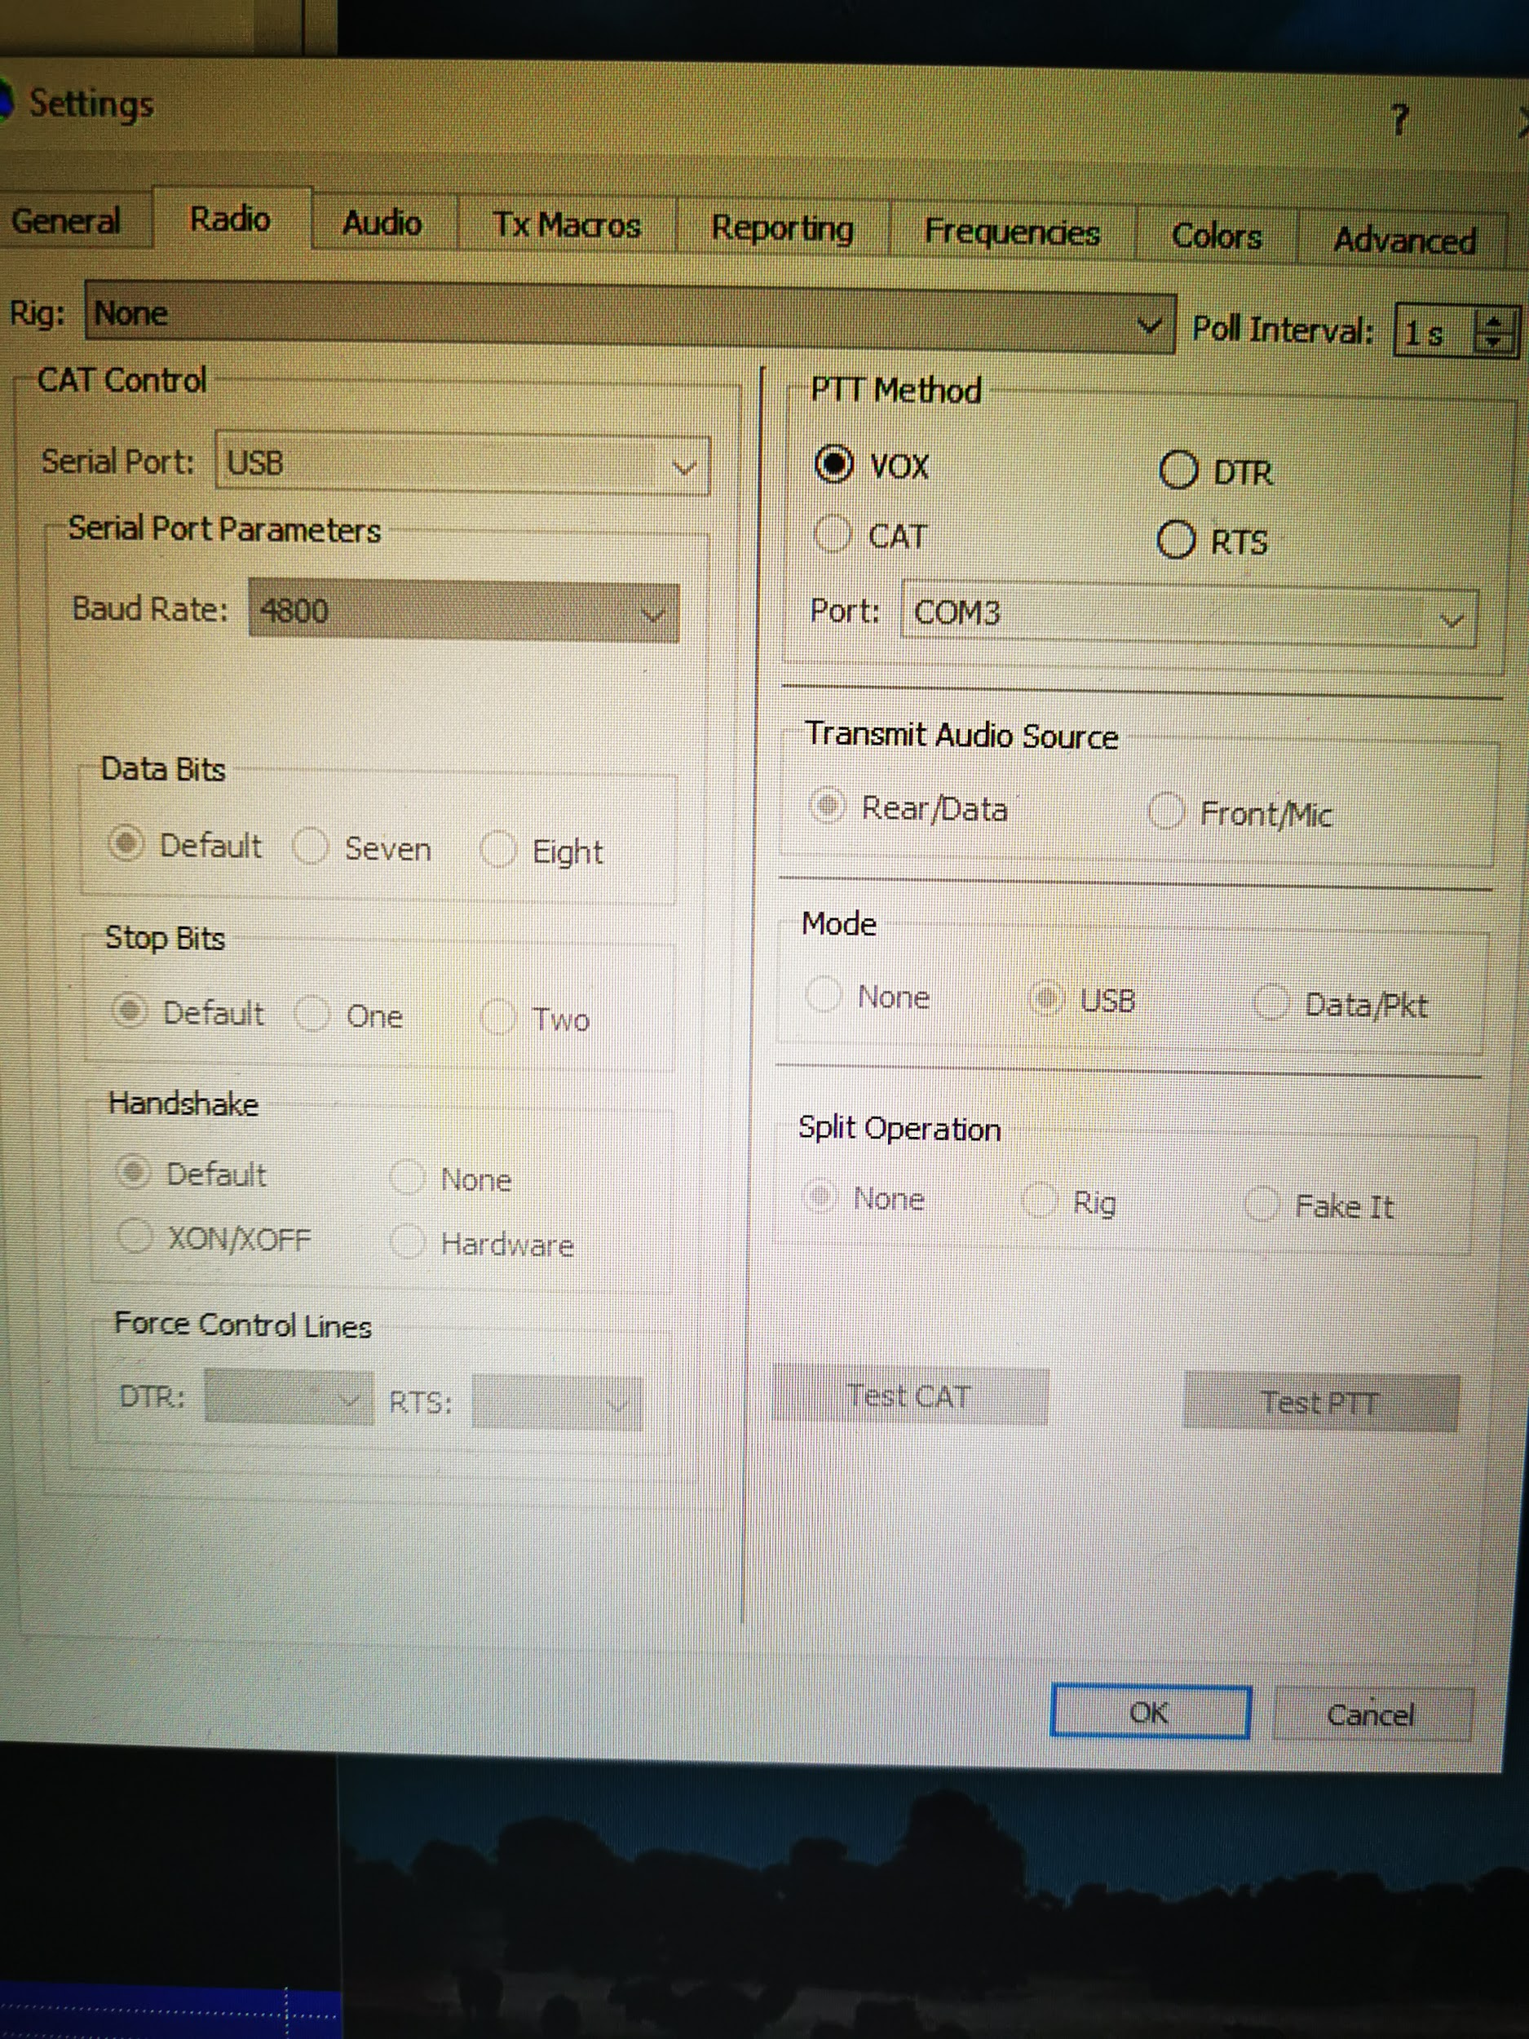
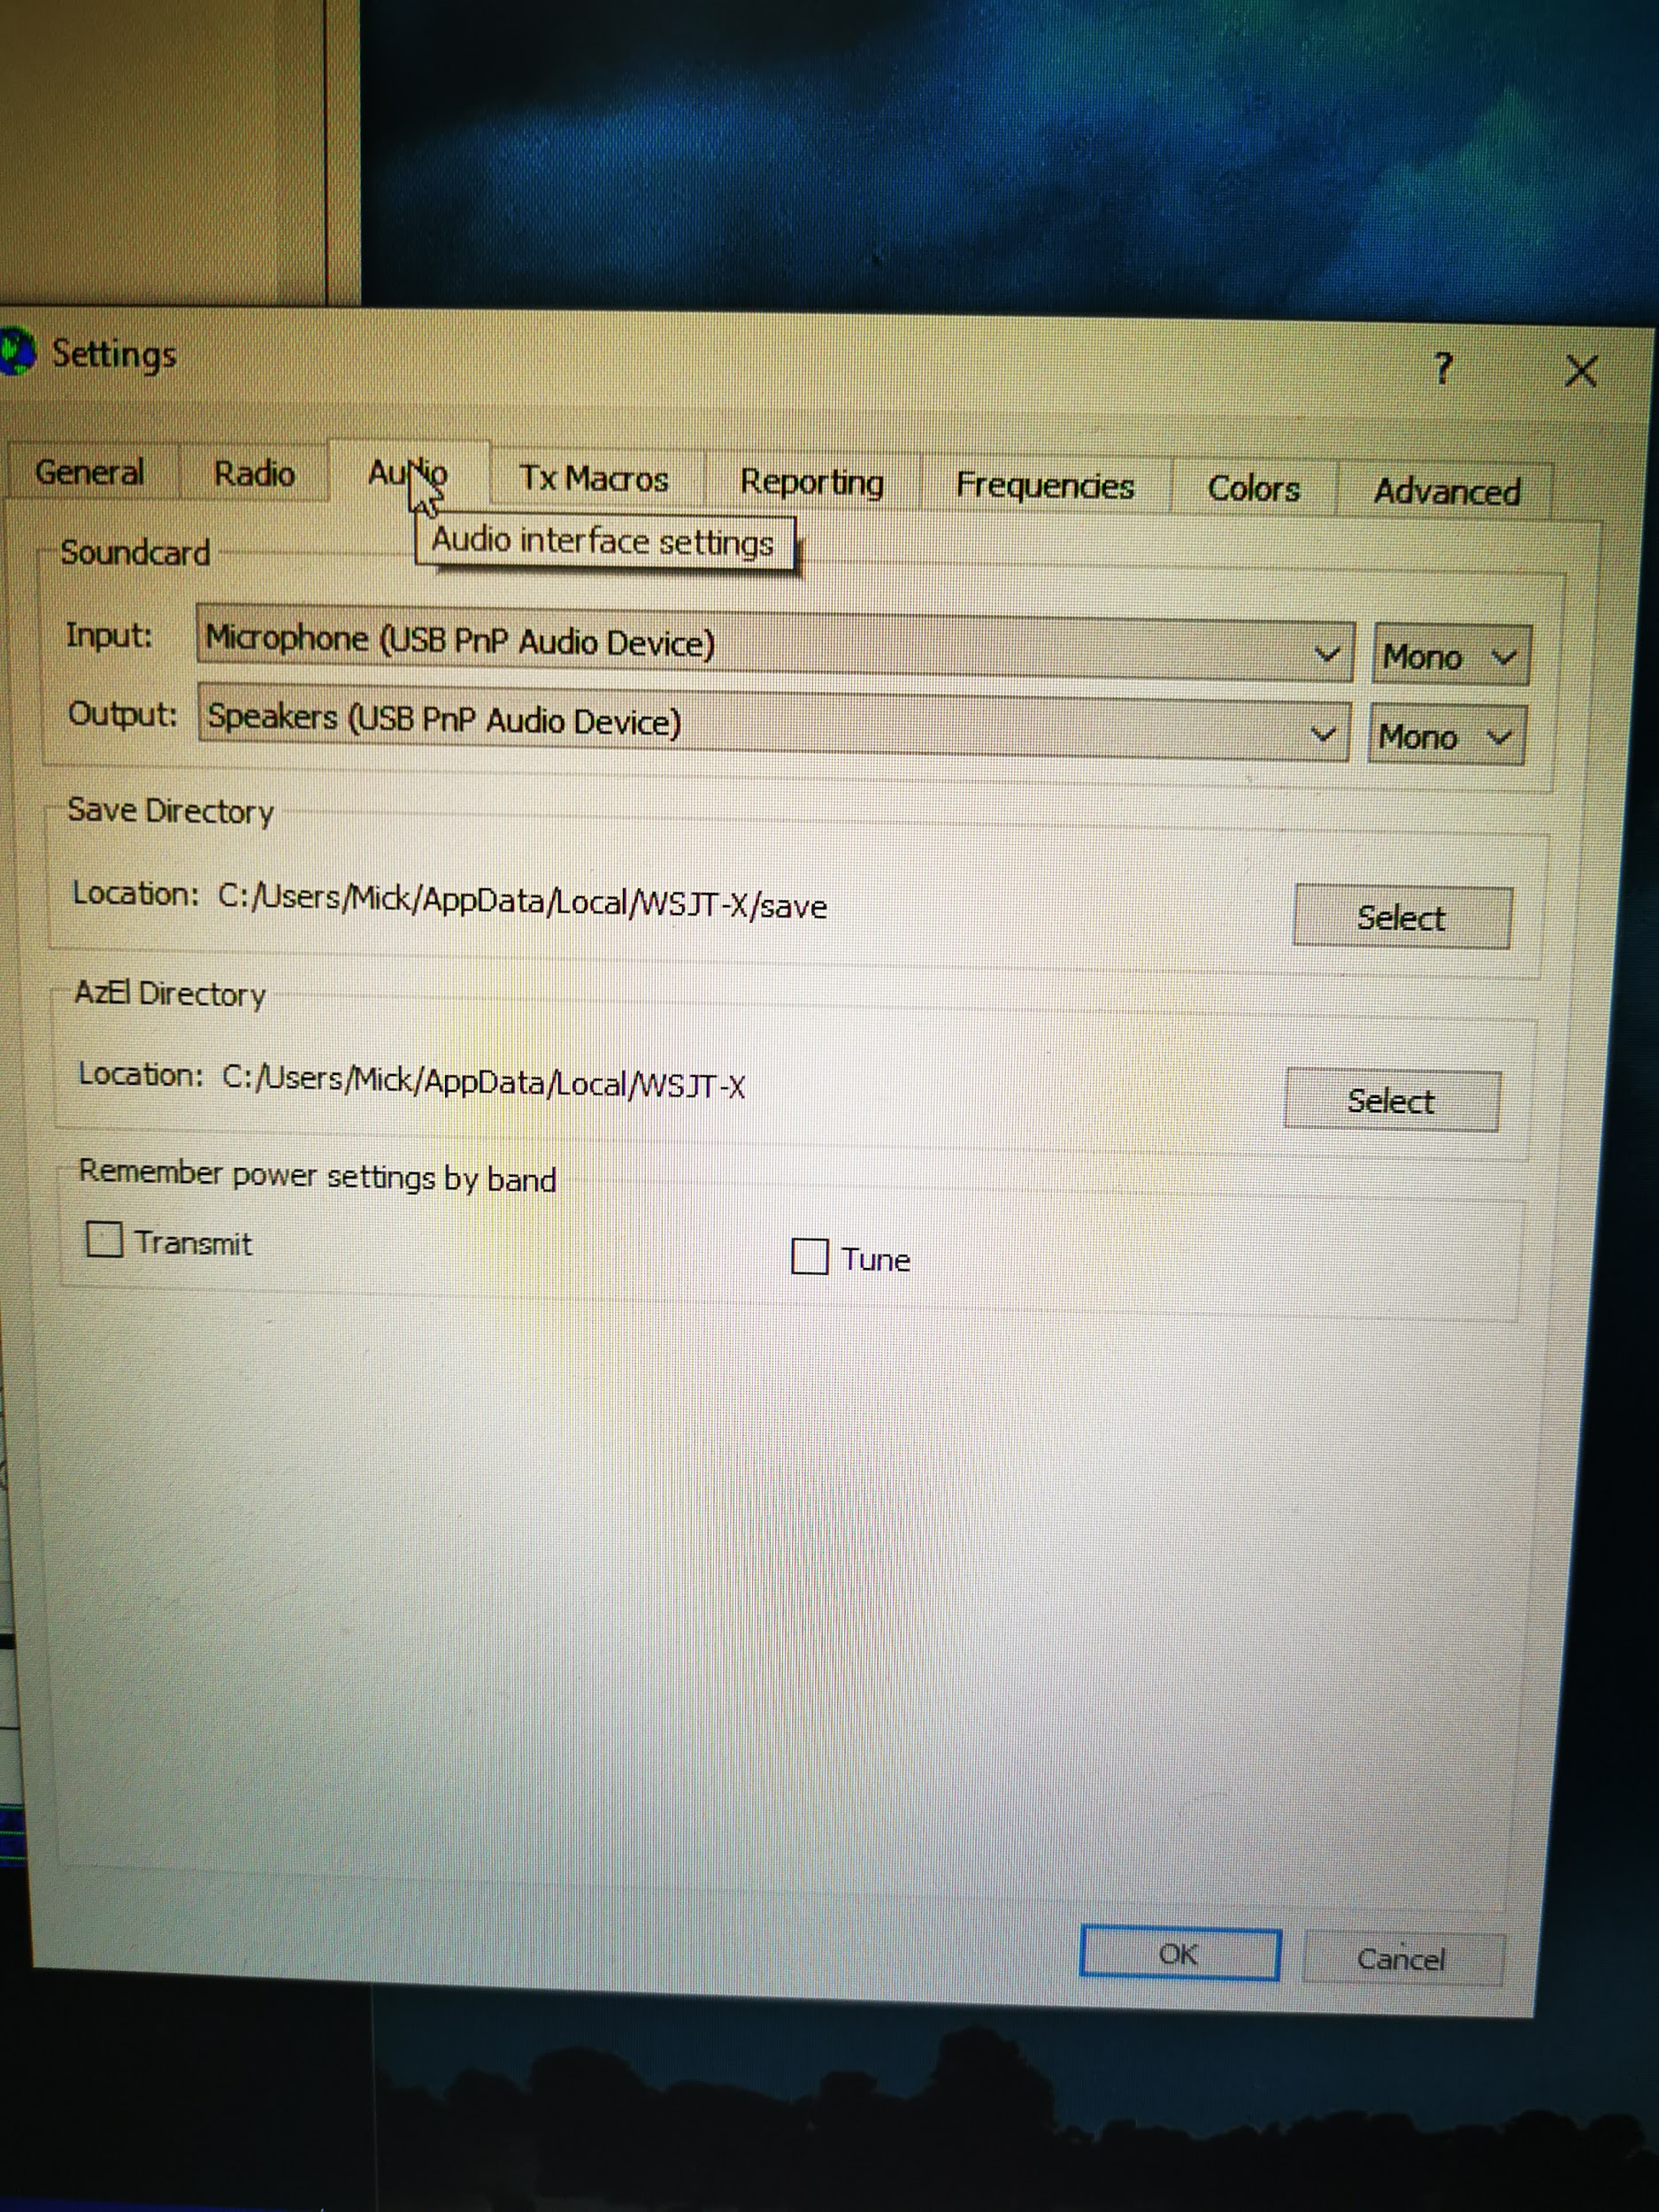
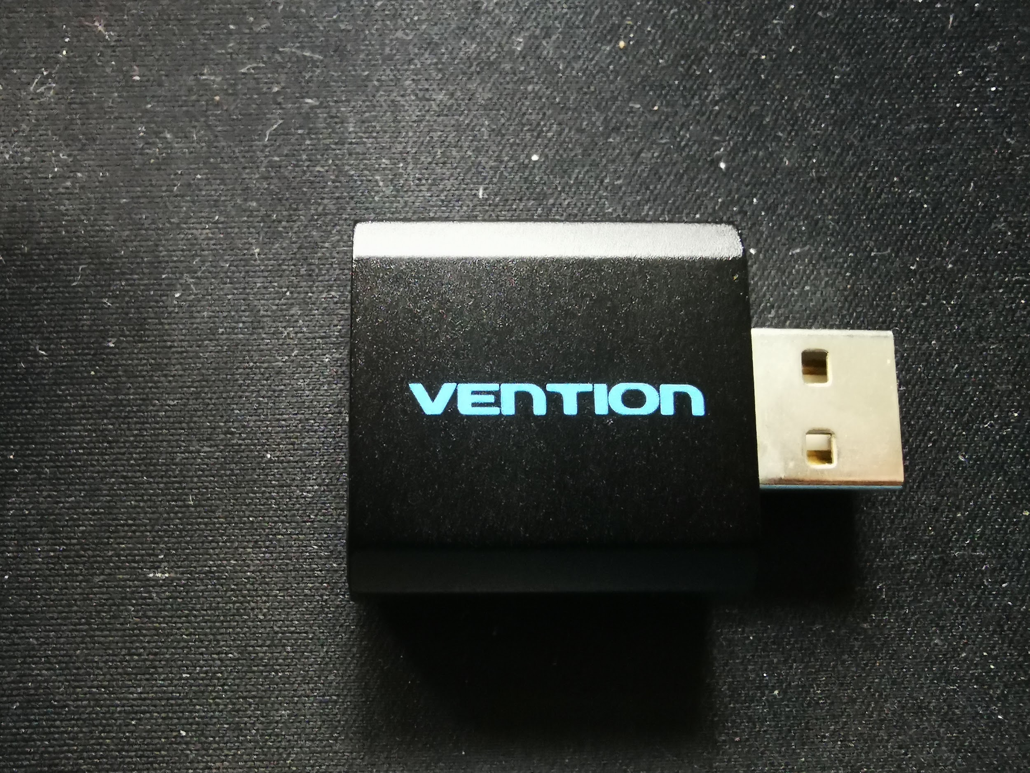
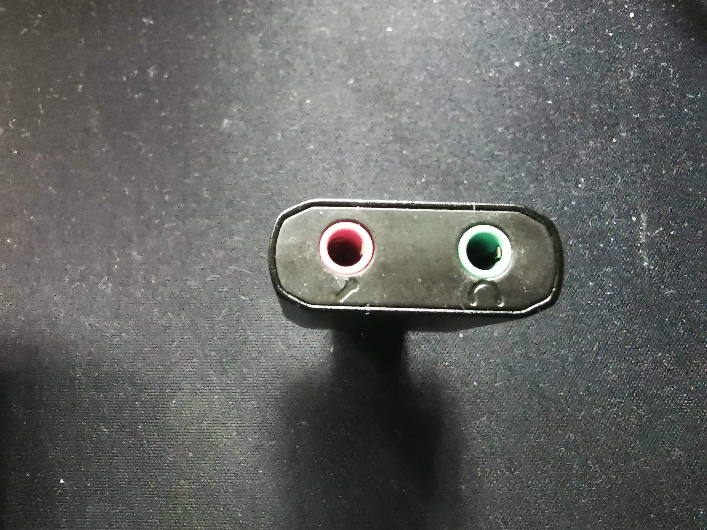
WSJT-X settings
Audio settings tab on WSJT-X. Just choose the sound card that you are using, make sure that you choose the correct device. You can have multiple devices on the drop down if you have other devices present in your system like USB audio sound card like the picture shown below.
WSJT-X Settings On the radio TAB, set as none

Slide 5
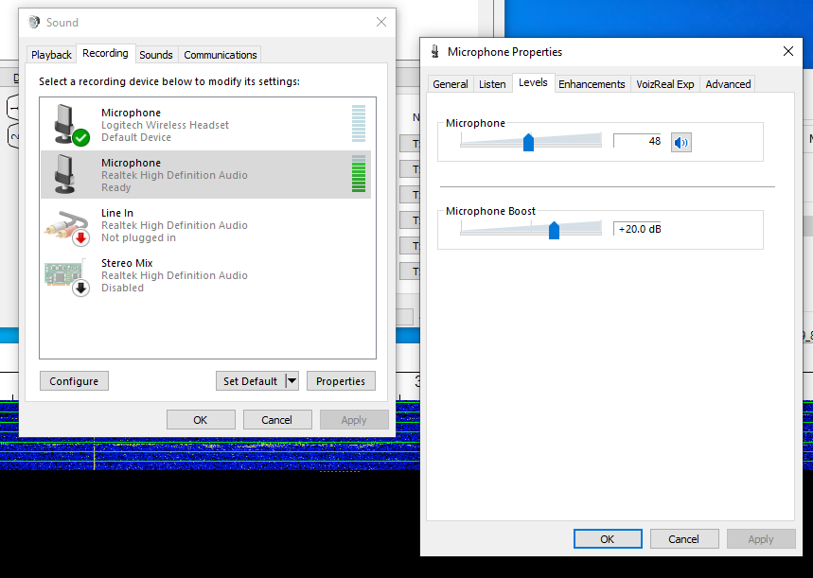
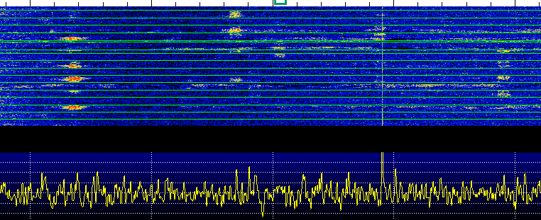
PC and audio settings (based on my experience)
PC settings
On windows sound settings recording tab (mic configurations), configure the sound card to at least get to 90% so you can have stronger visual signals on the waterfall, or adjust to get the optimum input levels.

Slide 6
Your ready to take off!
WSJTX, FLDigi, etc.
The digital world is now at your fingertips!
73! Enjoy!

